Slide 1
Carnegie Mellon
Computer Systems Organization
Jinyang Li
Some slides adapted from Tiger Wang’s

Slide 2
Why study CSO?

Slide 3




Your career path in the next few years
graduation
interview
programmer

Slide 4

Your career path in the next few years
graduation
interview
apply for graduate school
programmer
programmer & researcher

Slide 5

Your career path in the next few years
graduation
startup
interview
graduate school
programmer & researcher
programmer
Hire / become

Slide 6

Your career path in the next few years
graduation
lawyer
interview
startup
graduate school
programmer & researcher
Hire / become
programmer
Be able to

Slide 7

Your career path in the next few years
graduation
enjoy life
lawyer
interview
startup
graduate school
programmer & researcher
Hire / become
programmer
Be able to

Slide 8

Your career path in the next few years
graduation
enjoy life
lawyer
interview
startup
graduate school
programmer & researcher
Hire / become
Be able to
programmer
be in a relationship with

Slide 9
Taking CSO will affect each step in the path!

Slide 10
For Graduation
Required class
For CS major and minor
Prepare for more advanced system classes
Operating Systems
Compilers
Networks
Architecture
Distributed Systems

Slide 11
For Interview
This class adds to your CV
C Programming, UNIX, X86 Assembly …
Interview related topics
Basic knowledge of Array, String, Bit Manipulation

Slide 12
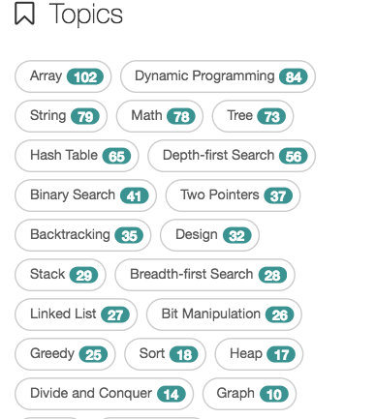
Topics Distribution From LeetCode
~30%
Some exercises in this class are derived from the real interview questions!
Our text books are considered as the
bibles of job interview.

Slide 13
For Graduate School Application
This class adds to your CV
A
Research related topics
Performance optimization
Memory layout and allocation, concurrent programming
Security
Buffer Overflow

Slide 14


Startup
The life you imagine
CEO
CTO
CFO
COO

Slide 15

Startup
Your real life: full stack programmer
Server
Website
Phone’s App
Optimizations

Slide 16

My lawyer friend
Numerous hours spent on extracting information from documents

Slide 17
My lawyer friend
I want to study programming.

Slide 18
My lawyer friend
I want to study programming.
Ok, you need to study CSO first.

Slide 19
My lawyer friend
I want to study programming.
Ok, you need to study CSO first.
Hmm…, I want to marry a programmer.

Slide 20
My lawyer friend
I want to study programming.
Ok, you need to study CSO first.
Hmm…, I want to marry a programmer.
Ok, you need to study CSO first.

Slide 21
My lawyer friend
I want to study programming.
Ok, you need to study CSO first.
Hmm…, I want to marry a programmer.
Ok, you need to study CSO first.
…The user is offline

Slide 22


Conversation between programmers
Have you heard of the Meltdown attack?
No. Is it bad?
Meltdown lets an attacker read another process’ address space!
What is an address space?
He does not know anything about computers...
Sorry I have to run now, bye!

Slide 23
For Programming
Understand how your program runs on the hardware
Why it fails
Why it is slow

Slide 24
Why it fails?
What is the result of 1000,000 * 1000,000 ?

Slide 25
Why it fails?
What is the result of 1000,000 * 1000,000 ?
Expected answer: 1000,000,000,000 (1 trillion)

Slide 26
Why it fails?
What is the result of 1000,000 * 1000,000 ?
Expected answer: 1000,000,000,000 (1 trillion)
int main()
{
int a = 1000000;
int b = 1000000;
int r = a * b;
printf("result is %d\n", r);
return 0;
}

Slide 27
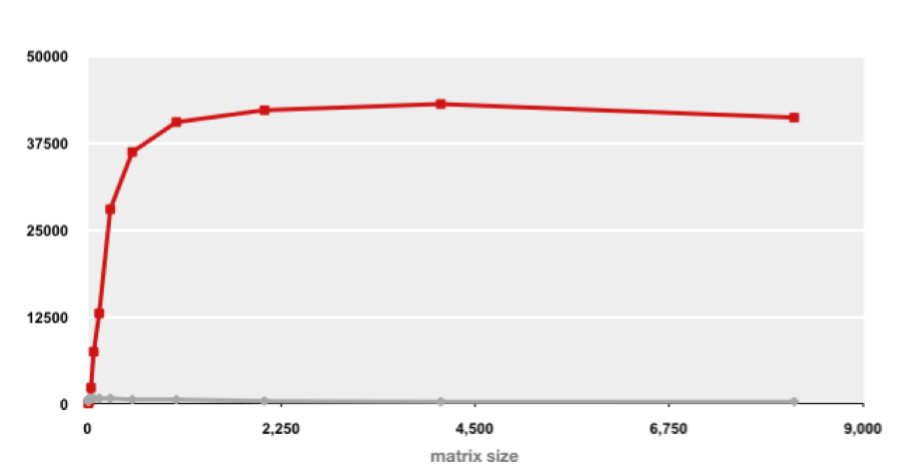
Why it is slow?
Carnegie Mellon
Example Matrix Multiplication
Best code (K. Goto)
Throughput
160x
Triple loop
Both implementations have exactly the same operations count (2n³)

Slide 28
What is CSO about?

Slide 29
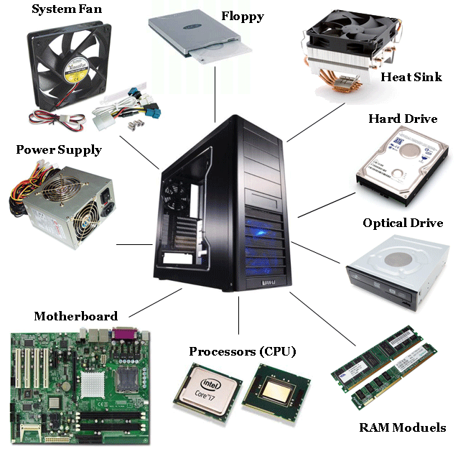
Computer System Organization

Slide 30


Computer System Organization
Printed Circuit

Slide 31

Computer System Organization
Printed Circuit

Slide 32
Layered Organization
Software
Hardware

Slide 33
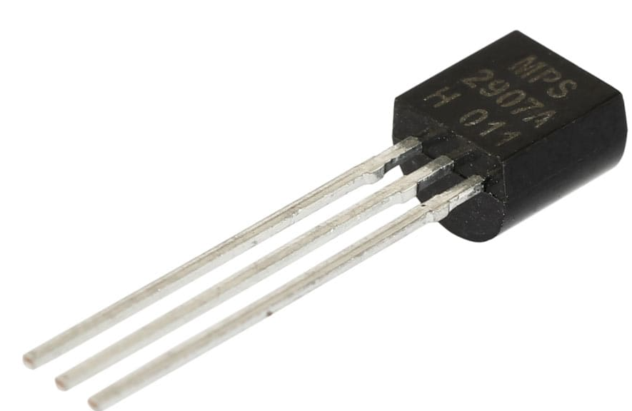
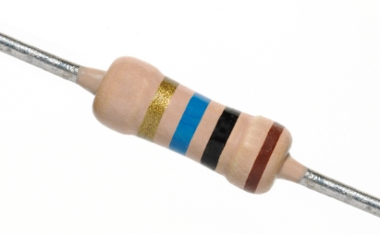

Layered Organization
Software
Hardware
Transistors
Diodes
Resistors

Slide 34
Layered Organization
Software
Hardware
Logical Circuits,
Flip-Flops, Gates
Transistors
Diodes
Resistors

Slide 35
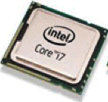
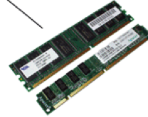
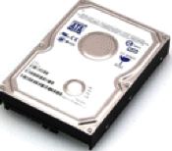
Layered Organization
Software
Hardware
CPU, Memory, Disk
Logical Circuits,
Flip-Flops, Gates
Transistors
Diodes
Resistors

Slide 36
Layered Organization
Software
Hardware
CPU
Memory
I/O
Logical Circuits, Flip-Flops, Gates, …
Transistors, Diodes, Resistors, …

Slide 37







Layered Organization
System Software
(OS, compiler, VM…)
Software
Hardware
CPU
Memory
I/O
Logical Circuits, Flip-Flops, Gates, …
Transistors, Diodes, Resistors, …

Slide 38






Layered Organization
User Applications
System Software
(OS, compiler, VM…)
Software
Hardware
CPU
Memory
I/O
Logical Circuits, Flip-Flops, Gates, …
Transistors, Diodes, Resistors, …

Slide 39

Layered Organization
Users
User Applications
System Software
(OS, compiler, VM…)
Software
Hardware
CPU
Memory
I/O
Logical Circuits, Flip-Flops, Gates, …
Transistors, Diodes, Resistors, …

Slide 40
Layered Organization
User App
User Applications
System Software
Operating System
Compilers
…
Software
Hardware
CPU
Memory
I/O
Logical Circuits, Flip-Flops, Gates, …
Transistors, Diodes, Resistors, …

Slide 41
Abstraction
User App
User Applications
System Software
Operating System
Compilers
…
Software
Hardware
CPU
Memory
I/O
Abstract Interface
Logical Circuits, Flip-Flops, Gates, …
Transistors, Diodes, Resistors, …

Slide 42
The Scope of This Class
User App
User Applications
System Software
Operating System
Compilers
…
Software
Hardware
CPU
Memory
I/O
Abstract Interface
Logical Circuits, Flip-Flops, Gates, …
Transistors, Diodes, Resistors, …

Slide 43
The Scope of This class
Focus on abstract interfaces exposed by
CPU and Memory
Operating System, Compilers
C Programming, OS Service, Memory Management, Concurrent Programming
System Software
Operating Systems and Compilers
Software
Hardware
Assembly, Virtual memory, Interrupt
CPU and Memory

Slide 44
Schedule
http://news.cs.nyu.edu/~jinyang/sp19-cso/schedule.html
C Programming
overview
bit, byte and int
float point
[C] basics, bitwise operator, control flow
[C] scopes rules, pointers, arrays
[C] structs, mallocs
[C] large program (linked list)

Slide 45
Schedule
http://news.cs.nyu.edu/~jinyang/sp19-cso/schedule.html
C Programming
overview
bit, byte and int
float point
[C] basics, bitwise operator, control flow
[C] scopes rules, pointers, arrays
[C] structs, mallocs
[C] large program (linked list)
Machine Prog: ISA, Compile, movq
Machine Prog: Control Code (condition, jump instruction)
Machine Prog: Array allocation and access
Machine Prog: Procedure calls
Machine Prog: Structure, Memory Layout
Machine Prog: Buffer Overflow
Code optimizations
Assembly (X86)

Slide 46
Schedule
http://news.cs.nyu.edu/~jinyang/sp19-cso/schedule.html
C Programming
overview
bit, byte and int
float point
[C] basics, bitwise operator, control flow
[C] scopes rules, pointers, arrays
[C] structs, mallocs
[C] large program (linked list)
Machine Prog: ISA, Compile, movq
Machine Prog: Control Code (condition, jump instruction)
Machine Prog: Array allocation and access
Machine Prog: Procedure calls
Machine Prog: Structure, Memory Layout
Machine Prog: Buffer Overflow
Code optimizations
Virtual memory: Address Spaces/ Translation, Goal
Virtual memory: Page table/physcial to virtual
Process
Assembly (X86)
Virtual Memory

Slide 47
Schedule
http://news.cs.nyu.edu/~jinyang/sp19-cso/schedule.html
C Programming
overview
bit, byte and int
float point
[C] basics, bitwise operator, control flow
[C] scopes rules, pointers, arrays
[C] structs, mallocs
[C] large program (linked list)
Machine Prog: ISA, Compile, movq
Machine Prog: Control Code (condition, jump instruction)
Machine Prog: Array allocation and access
Machine Prog: Procedure calls
Machine Prog: Structure, Memory Layout
Machine Prog: Buffer Overflow
Code optimizations
Virtual memory: Address Spaces/ Translation, Goal
Virtual memory: Page table/physcial to virtual
Process
Dynamic Memory Allocation I: malloc, free
Dynamic Memory Allocation II: design allocator
Dynamic Memory Allocation III: futher optimization
Assembly (X86)
Virtual Memory
Memory Management

Slide 48
Schedule
http://news.cs.nyu.edu/~jinyang/sp19-cso/schedule.html
C Programming
overview
bit, byte and int
float point
[C] basics, bitwise operator, control flow
[C] scopes rules, pointers, arrays
[C] structs, mallocs
[C] large program (linked list)
Machine Prog: ISA, Compile, movq
Machine Prog: Control Code (condition, jump instruction)
Machine Prog: Array allocation and access
Machine Prog: Procedure calls
Machine Prog: Structure, Memory Layout
Machine Prog: Buffer Overflow
Code optimizations
Virtual memory: Address Spaces/ Translation, Goal
Virtual memory: Page table/physcial to virtual
Process
Dynamic Memory Allocation I: malloc, free
Dynamic Memory Allocation II: design allocator
Dynamic Memory Allocation III: futher optimization
Concurrent Programming I: thread, race
Concurrent Programming II: lock
Concurrent Programming III: conditional variable
Concurrent Programming IV: Other primitives
Assembly (X86)
Virtual Memory
Memory Management
Concurrent Programming

Slide 49
Course Perspective
Carnegie Mellon
Most Systems Courses are Builder-Centric
Computer Architecture
Design pipelined processor in Verilog
Operating Systems
Implement large portions of operating system
Compilers
Write compiler for simple language
Networking
Implement and simulate network protocols

Slide 50
Course Perspective
Carnegie Mellon
Most Systems Courses are Builder-Centric
Computer Architecture
Design pipelined processor in Verilog
Operating Systems
Implement large portions of operating system
Compilers
Write compiler for simple language
Networking
Implement and simulate network protocols

Slide 51

Course Perspective (Cont.)
Carnegie Mellon
This course is programmer-centric
Understanding of underlying system makes a more effective programmer
Bring out the hidden hacker in everyone

Slide 52
Course workload
Lectures: M/W 11am-12:15pm, 60 5th Ave C12
Recitation: T 9:30-10:45am, 60 5th Ave C10
Homework:
Recitation exercises
to be finished on the day of recitation
5 Programming labs
Quizzes:
Quiz 1 (3/4)
Quiz 2 (4/3)
Final exam (5/15)
Starts tomorrow! Bring Laptop to class

Slide 53
Grade Breakdown
Recitation exercises 15%
Labs 40%
Quiz-1 10%
Quiz-2 15%
Final 20%
Bonus I: lecture and piazza participation 5%
Bonus II: extra-credit lab questions

Slide 54
Optional class project
To challenge yourself more, do a class project instead of taking quiz-2 and final.
To qualify for the project option, you must:
Form a team of 2
Score >= 85% on quiz-1
Finish lab-1, 2, 3 before 3/13.
How your project will be evaluated:
Presentation + demo

Slide 55
Is CSO going to be hard?

Slide 56
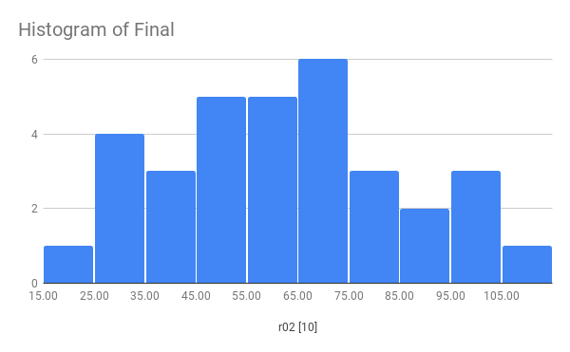
Statistics from last term: Final

Slide 57

It’s time to work hard
You must be prepared to devote >15 hours/week

Slide 58
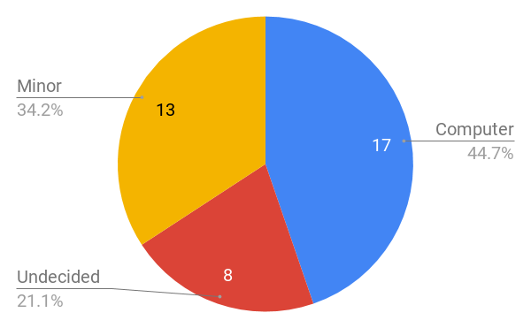
Statistics from this term: major vs. minor

Slide 59
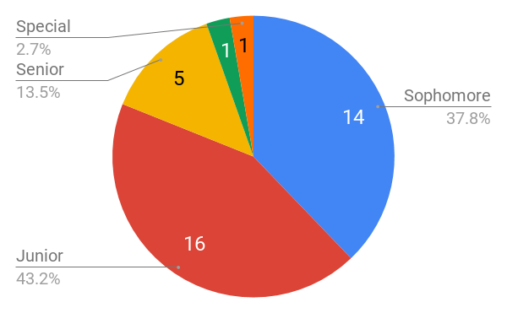



Statistics from this term: student level

Slide 60
We are here to help
Jinyang Li
Lecturer
Lingfan Yu
Jingyu Liu
Recitation Leader
Head grader
Grader
cso-staff@cs.nyu.edu

Slide 61
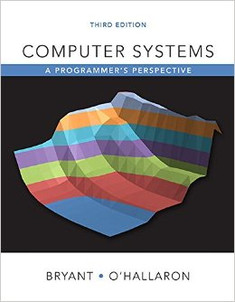
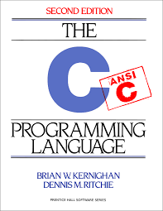
Before Class
Read the related sections in the text books
“Computer Systems: A Programmer’s Perspective, 3nd Edition”, http://csapp.cs.cmu.edu
“The C Programming Language, 2nd Edition”, Prentice Hall, 1988,
Reserved at NYU library

Slide 62
Be Active In Class
Raise your hand at any time
Ask me to repeat, repeat and repeat
Ask questions
Answer questions from me or others
Befriend your classmates and form study groups

Slide 63
After Class
Finish all labs / recitation exercises by yourself
Attend the recitations
Getting help
Office hour, Piazza

Slide 64
Policies
Carnegie Mellon
You must work alone on all assignments
You may post questions on Piazza,
You are encouraged to answer others’ questions, but refrain from explicitly giving away solutions.
Labs & Exercises
Everybody has 5 grace days (incremented at half day granularity)

Slide 65
Class Info
http://news.cs.nyu.edu/~jinyang/sp19-cso/
Recitation starts tomorrow,
bring your laptop to class

Slide 66
Integrity and Collaboration Policy
Carnegie Mellon
We will enforce the policy strictly.
The work that you turn in must be yours
You must acknowledge your influences
You must not look at, or use, solutions from prior years or the Web, or seek assistance from the Internet
You must take reasonable steps to protect your work
You must not publish your solutions
If there are inexplicable discrepancies between exam and lab performance, we will over-weight the exam and interview you.
Do not turn in labs/exercises that are not yours
You won’t fail because of one missing lab

Slide 67
Integrity and Collaboration Policy
Carnegie Mellon
We will enforce this policy strictly and report violators to the department and Dean.

